Slide 1
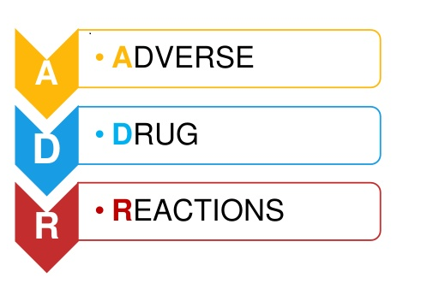
Any response to a drug that is noxious and unintended and that occurs at doses of an appropriately given drug used in man for prophylaxis, diagnosis or therapy.

Slide 2
ADR Reporting Procedure
Who can report
What to report
How to report
Whom to report
Where to report

Slide 3
Who can report? How to report? and whom to report?
Health Care Professionals
AMCs
Industry
NCC-PvPI
Ghaziabad
Consumer

Slide 4
What to Report ?
All types of suspected adverse reactions
Known or unknown
Serious or non-serious and
Frequent or rare
Reactions from all types of pharmaceutical products
Allopathy
Ayurvedic
Vaccines
Medical devices etc.

Slide 5
How & Whom to Report?
Use the ‘Suspected Adverse Drug Reaction Reporting Form/Medicine side effect Reporting form which is available on the official website of www.neongroup.com
Filled ADR form submitted to nearest ADR Monitoring Canters (AMCs) or directly to the Neon Laboratories Ltd.

Slide 6
A reporter can also report ADR via Helpline number
+918767559938
Neon Laboratories Ltd.

